Slide 1
Research Computing Update
October 2020

Slide 2
HPC Resources
New HPC Procurement via ANKABUT
Technical evaluation completed, and in commercial stage.
Process progressing, with procurement re-floating the RPF.
Funds have been made available, and expect PO to be issued shortly.

Slide 3
Training
“Research Computing intro session”, “Introduction to Linux”, and “Introduction to HPC” courses are all well attended and well received.
Training calendar is available at https://teamup.com/ksquu2jki56nesnr6n
Due to course being online, places are limited to 5 per session.
All three courses are delivered on a weekly basis.
Currently no courses regularly scheduled as demand has dropped.
“Research Computing intro session”, is mandatory for new accounts on HPC and is delivered when required.
Developed and delivered two specific Python based courses to a small group of students, as part of a larger AI course being delivered by faculty.

Slide 4
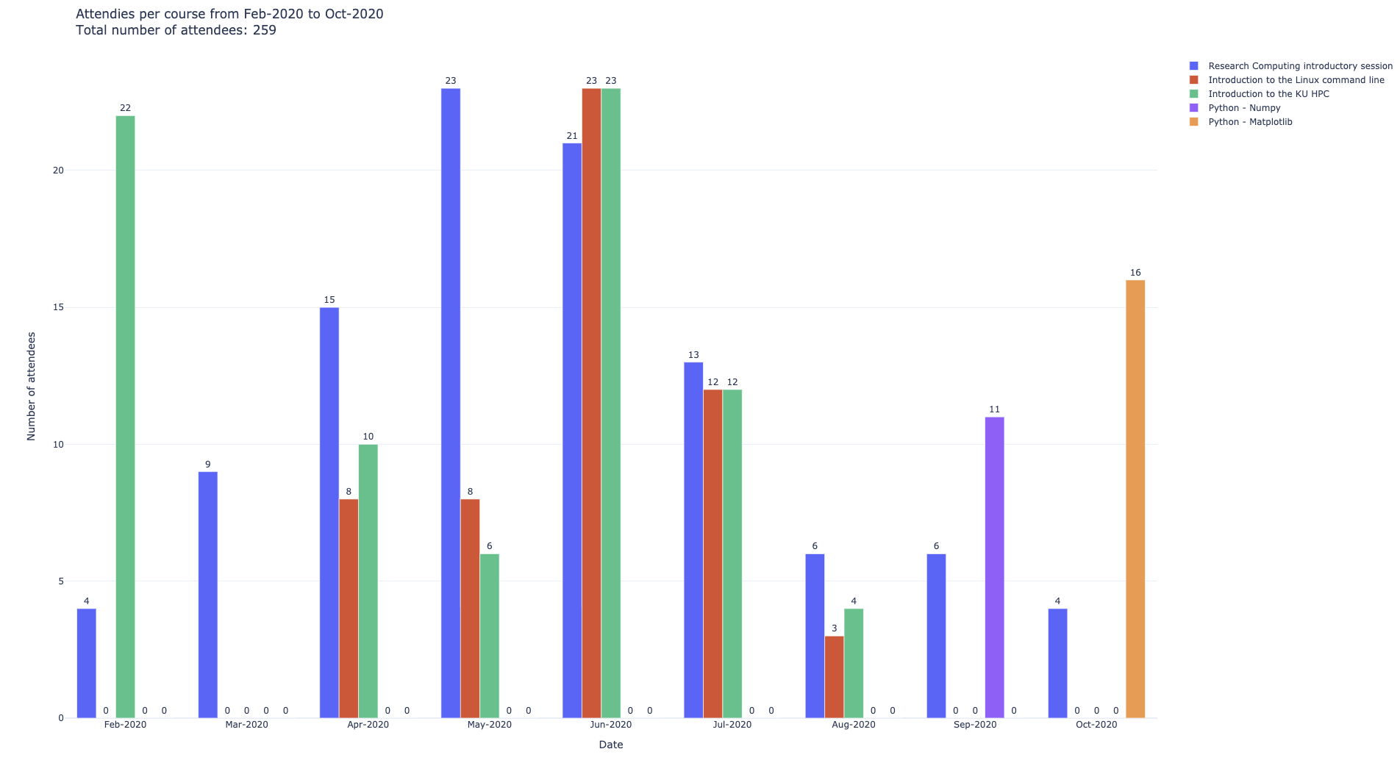

Slide 5
Resource Utilization

Slide 6
KU Cluster core distribution

Slide 7
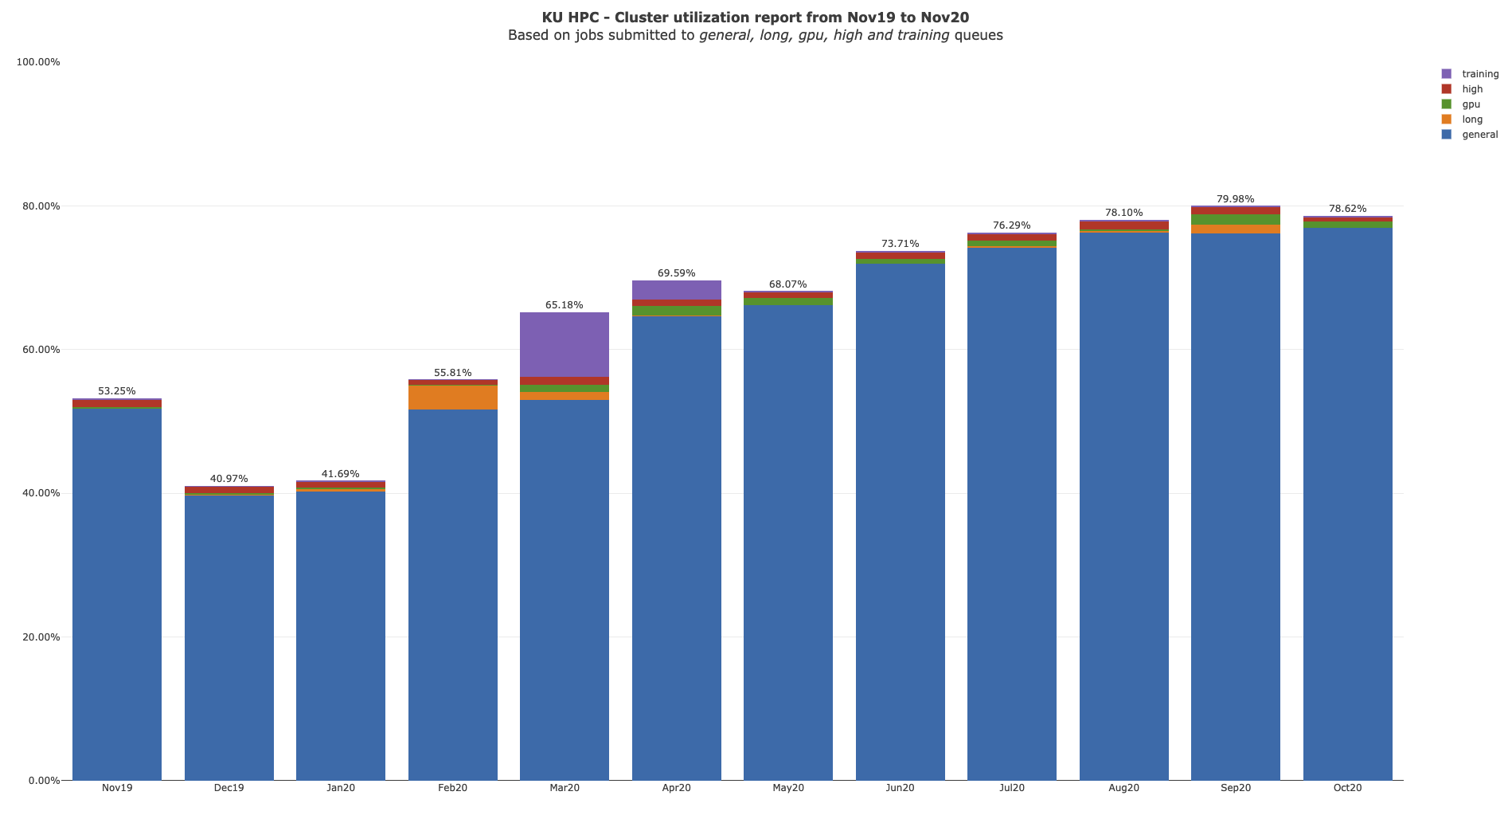

Slide 8
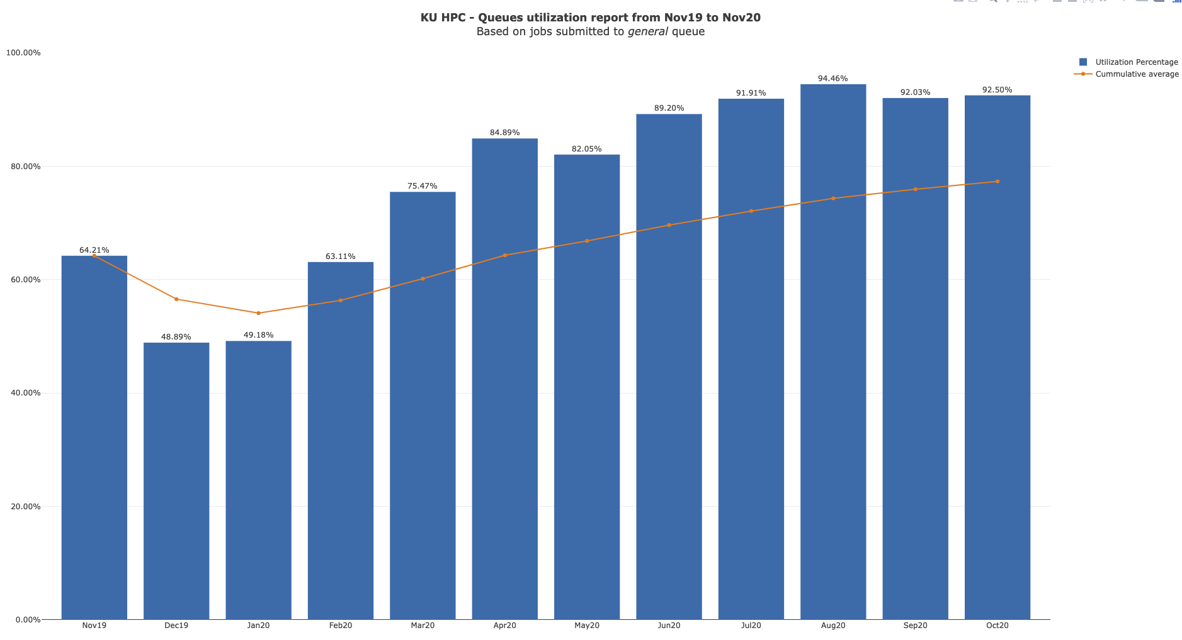

Slide 9
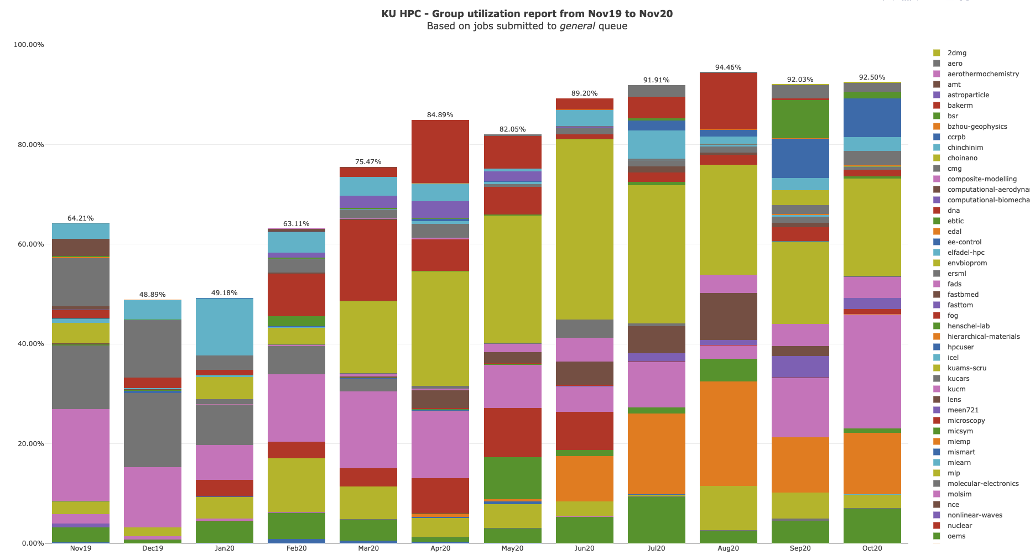

Slide 10
KU HPC Group Utilization for October 2020.
Note that do not yet keep track of applications used automatically. This is a work in progress, and will be added to future reports.

Slide 11
PI Cluster core distribution

Slide 12
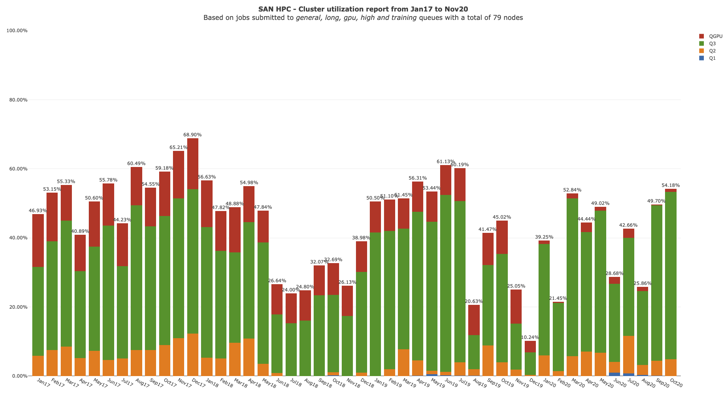

Slide 13
Status of KPI’s

